Slide 1

Vision Based Cloud Robotics
Mohan Muppidi, Joaquin Labrado
ACE Laboratory, UTSA

Slide 2


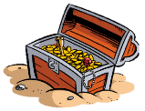




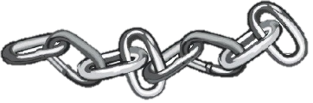
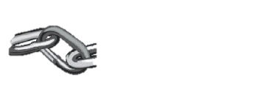

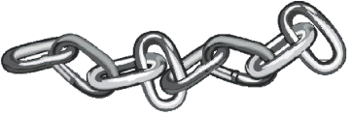

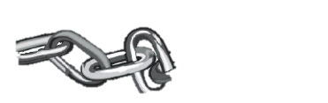


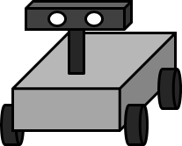
Overview (cntd..)
Cloud
Image Transfer
Start
Robot

Slide 3
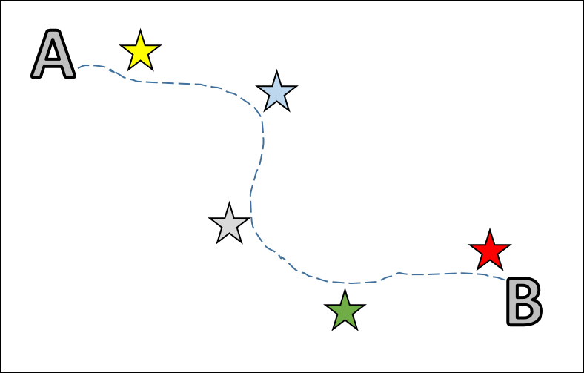
Introduction
Two questions help humans navigate their environment
“What does the world around me look like?”
“Where am I in this world”
This problem of navigation is often solved with
Simultaneous Localization And Mapping (SLAM)
If odometry and localization are based on image data then it is called Visual SLAM or VSLAM in short.

Slide 4
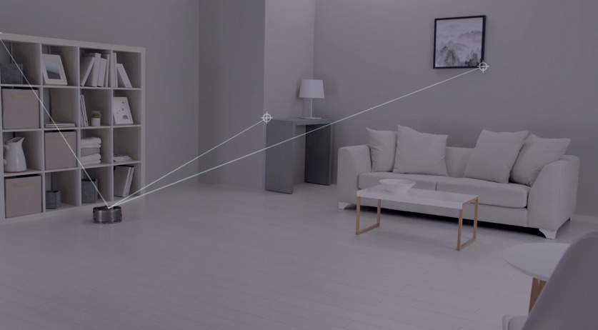
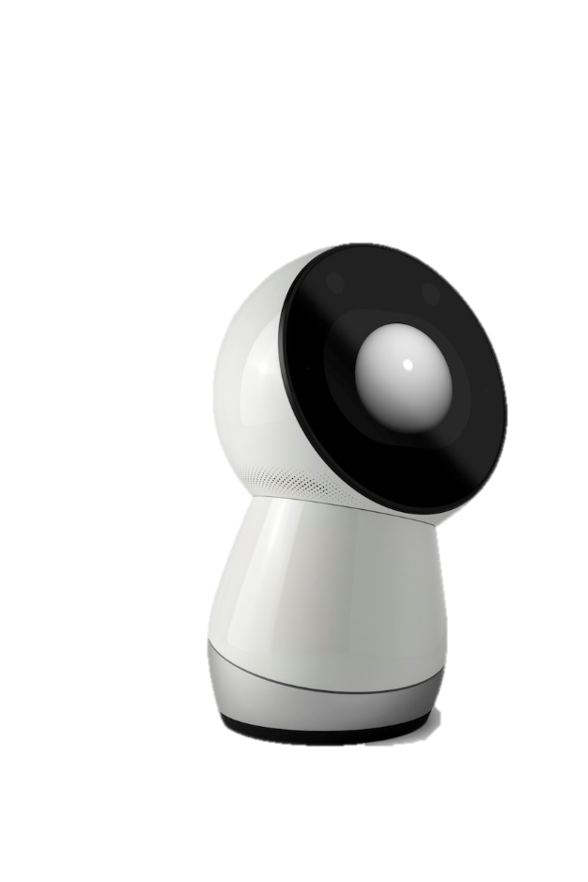
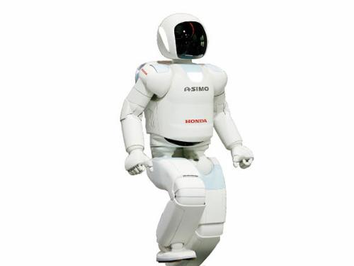
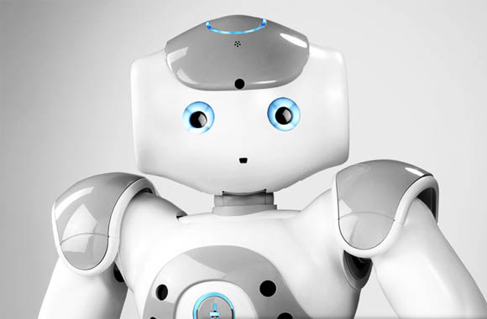
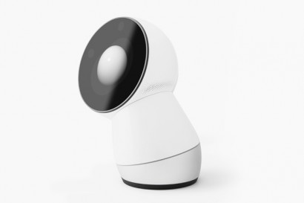
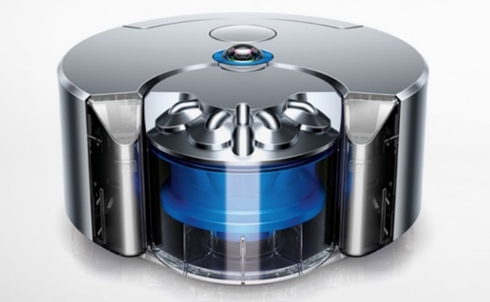
Introduction (cntd..) Applications
Personal Robots
Vacuum Cleaning Robots
Assistive robots
Robotic guides in Museums
Assistive robots in Libraries
Unmanned Aerial Vehicles
Dyson 360 eye navigation
Asimo robot
Nao robot
Jibo robot
Dyson 360 eye

Slide 5
Container based SLAM
Humans easily remember complex objects (such as trees, signboards or shops) as landmarks.
Robot remembering or storing such complex objects is not only computationally expensive but also time consuming.
Similar to how humans navigate their environment this research uses images to also identify landmarks.
World is divided into a grid with 1x1 blocks. Each grid is treated as a container with landmark images.
For ease of localization these blocks are grouped to follow a convention

Slide 6
Container based SLAM (cntd..)
Odometry of robot can be determined by
IMU
Encoders
Visual Odometry etc.
Images are treated as landmarks. Each container has 8 landmark images covering the 360⁰ view of robot
Naming convention is followed so that coordinates of that container can be determined from the name itself

Slide 7
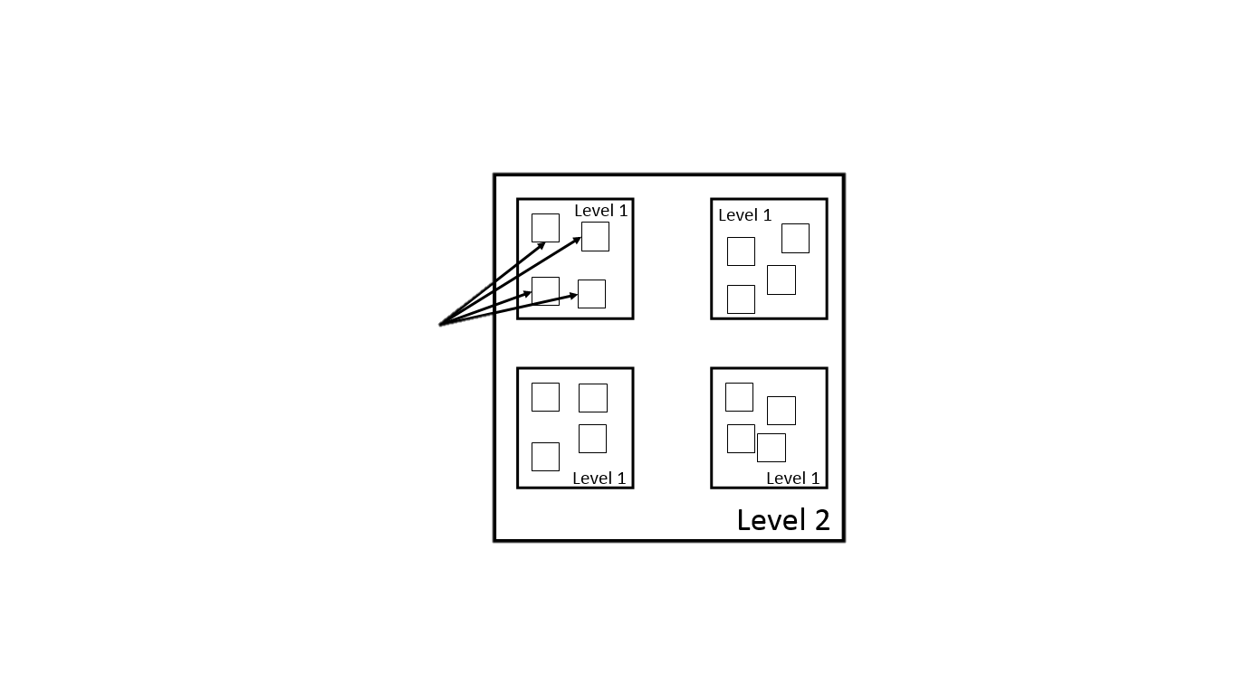
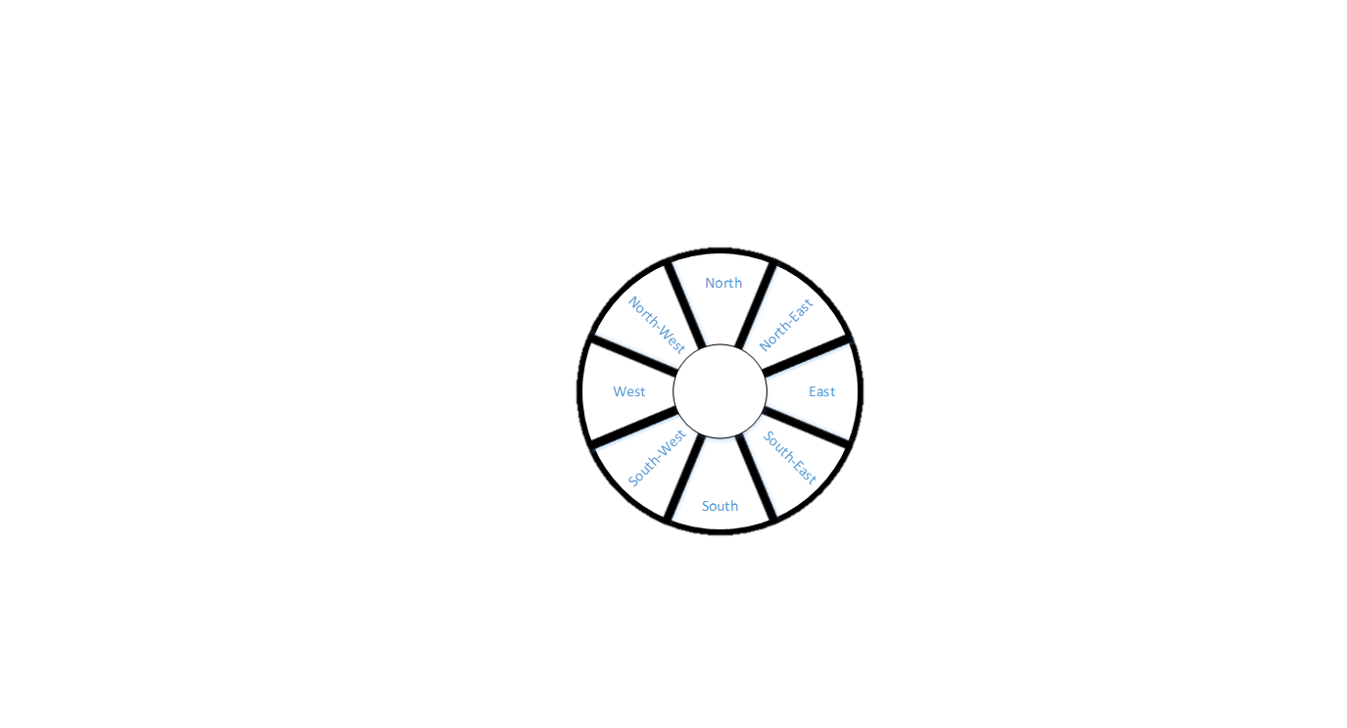
Container based SLAM (cont..)
Level 0
Illustration of levels in landmark database
360⁰ robot view divided into 8 segments

Slide 8
Localization
Localization
“Where am I in this world ?”
Localization helps robot to know its current location in an environment with respect to base frame
Advantage of the localization algorithm is that the landmark database created using Container based SLAM can be used to localize any robot
Image feature matching based localization

Slide 9
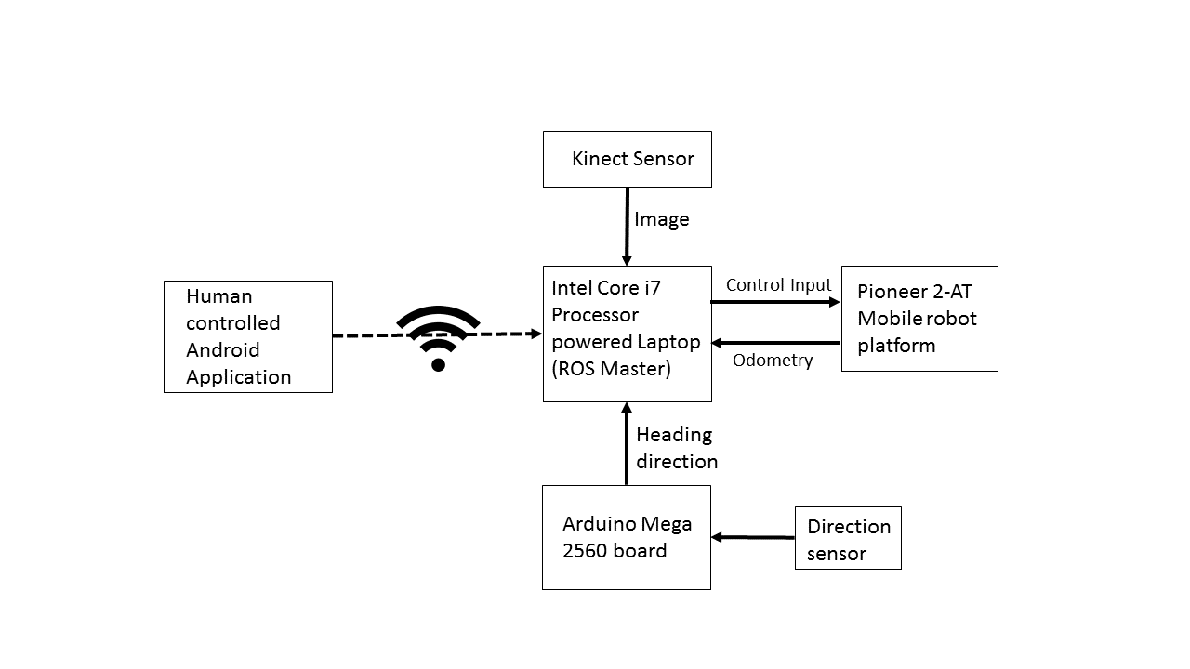
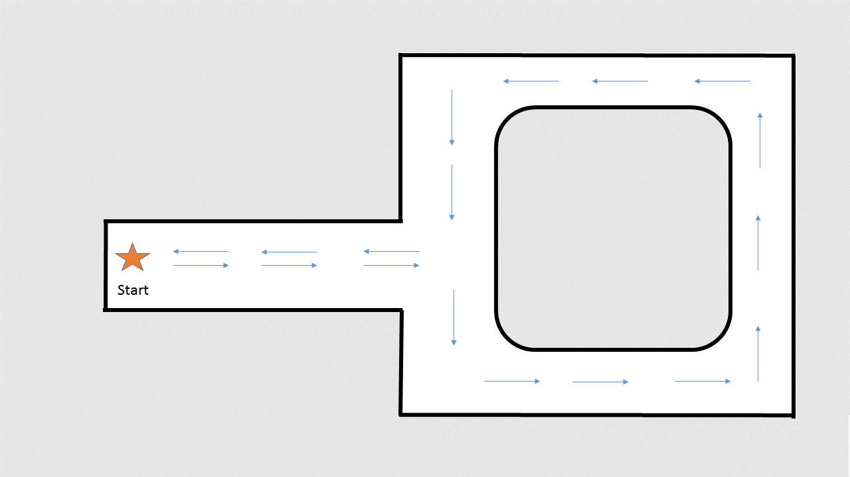
Experiment
The experiment was conducted on the 2nd floor hallway of UTSA Bio Sciences and Engineering building. The experiment started and ended at same location with the hallway as shown below

Slide 10
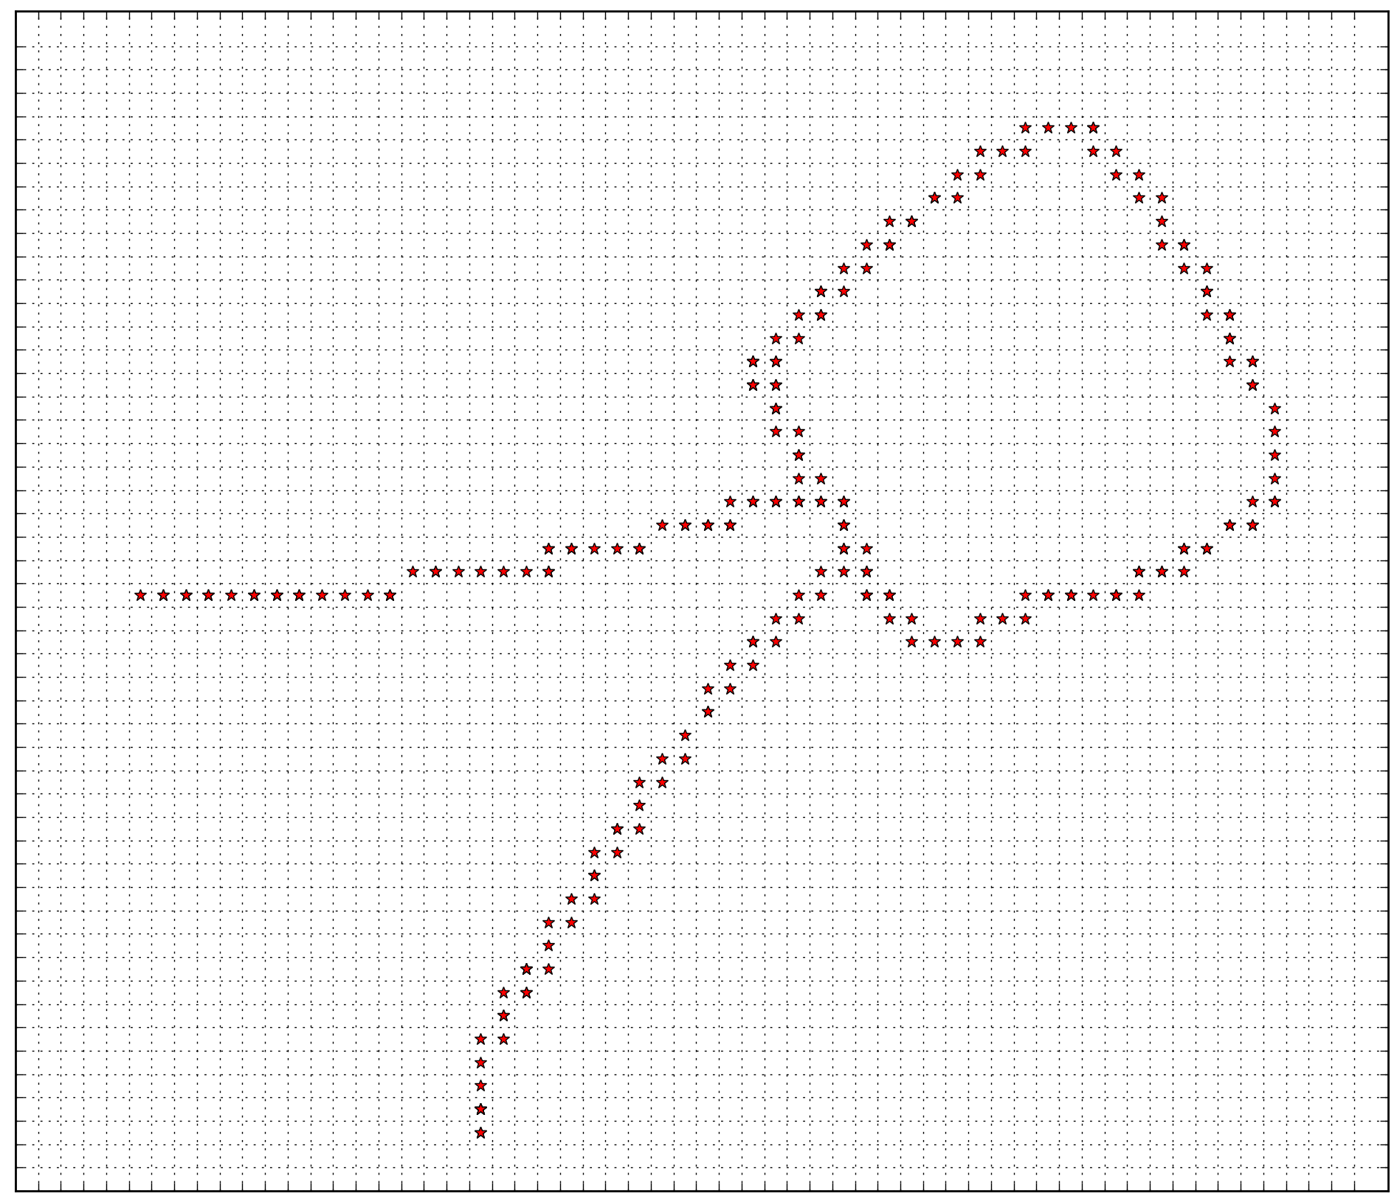
Landmark Database created using SLAM

Slide 11
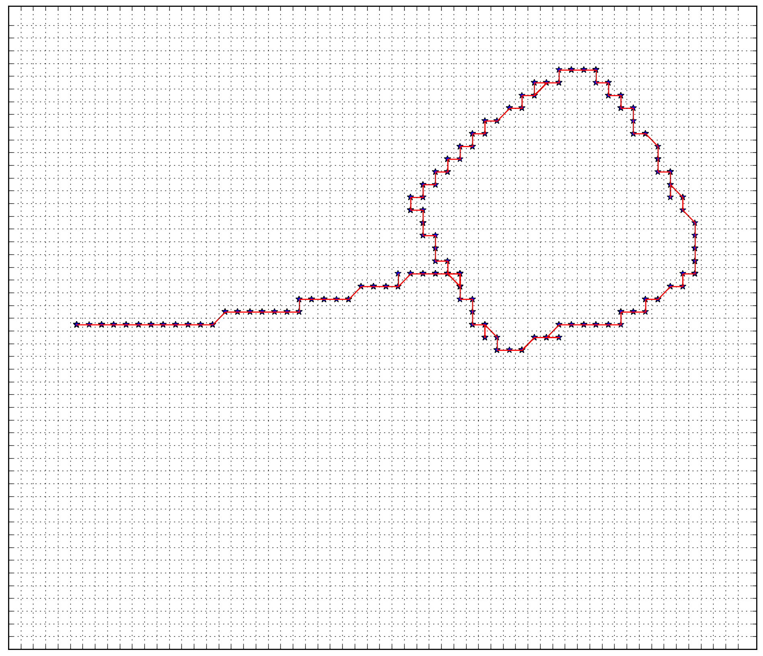
Localization of Robot based on previously built database

Slide 12
CLOUD BASED LOCALIZATION
Limitations of Localization Algorithm
The robot has to be in immediate or next neighborhood of the previous location before next sample is taken
If not in this area then full database has to be searched, Time consuming and slows down the robot.
Overcoming the Limitations
Performing parallel search
Offloading some computing from on board computer

Slide 13
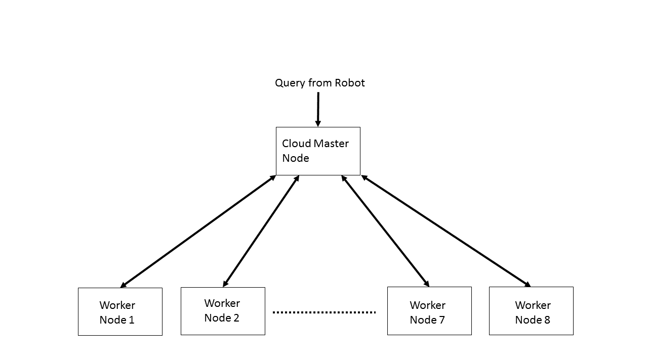
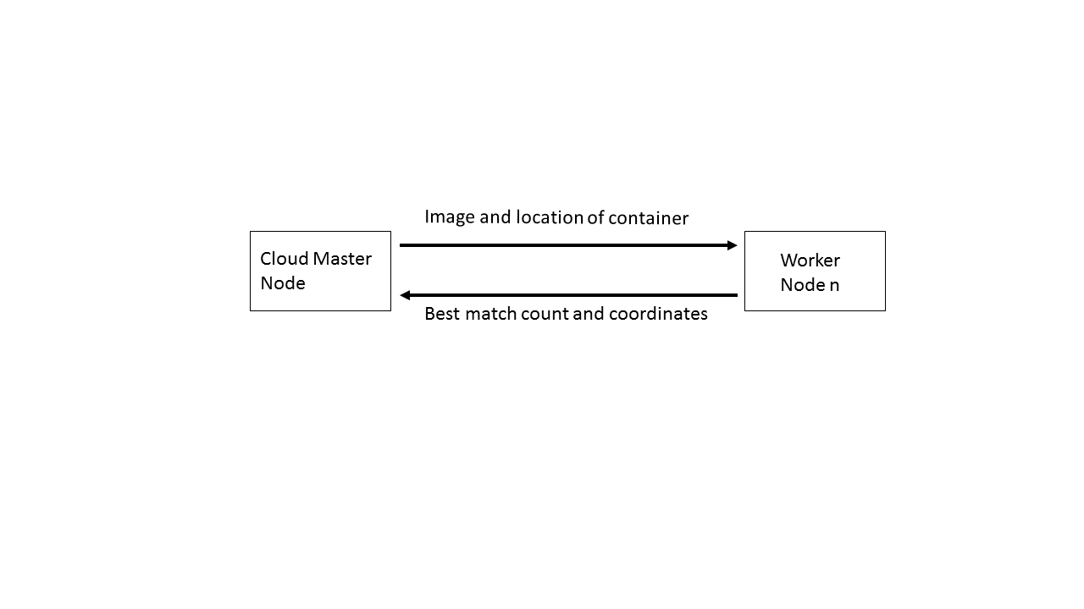
Illustration of cloud based parallel processing using ROS

Slide 14

Time comparison between results with parallel algorithm and serial algorithms
Serial Algorithm results
8.23 seconds per 100 frames
Without any manipulation such
as resizing or cropping on
Database images
Parallel Algorithm results
1.84 seconds per 100 frames
Without any manipulation such as resizing or cropping on database images
77%

Slide 15
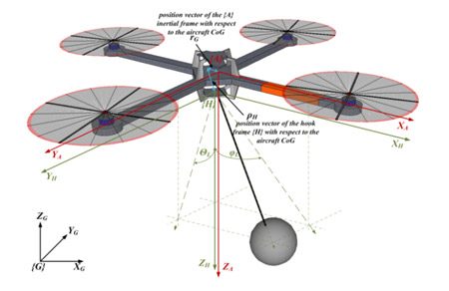
Quadrotors
Fly through the use of 4 motors
Many different applications
Swarms
Eye in the Sky

Slide 16
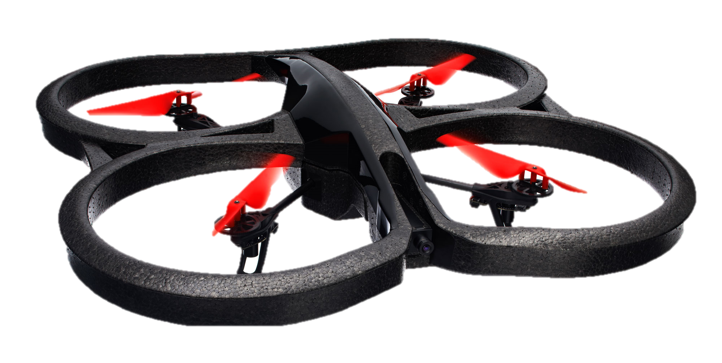
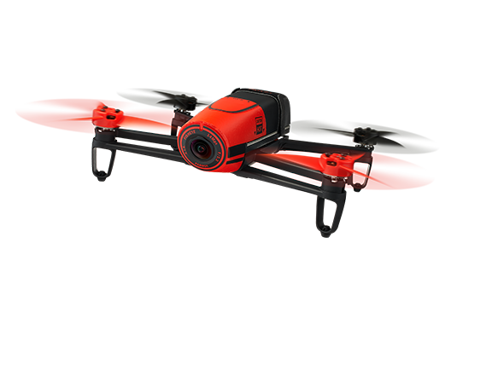
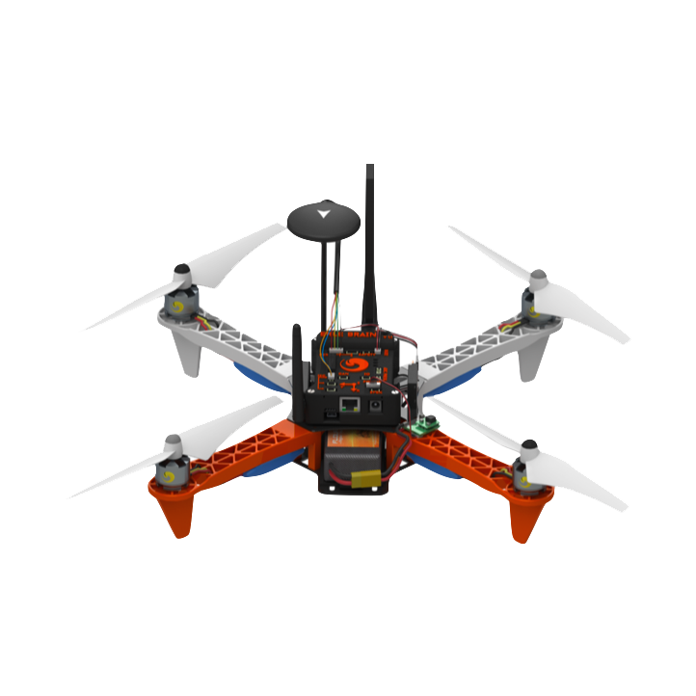
Quadrotors
In the Lab
ARDrone 2.0
Parrot Bebop
Erle Copter

Slide 17
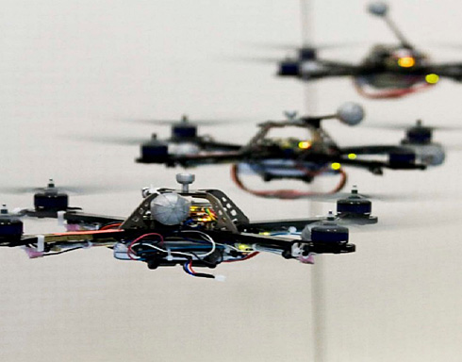
Formation Control
Multiple UAS's flying and moving as a group
Useful for localization
SAR applications

Slide 18
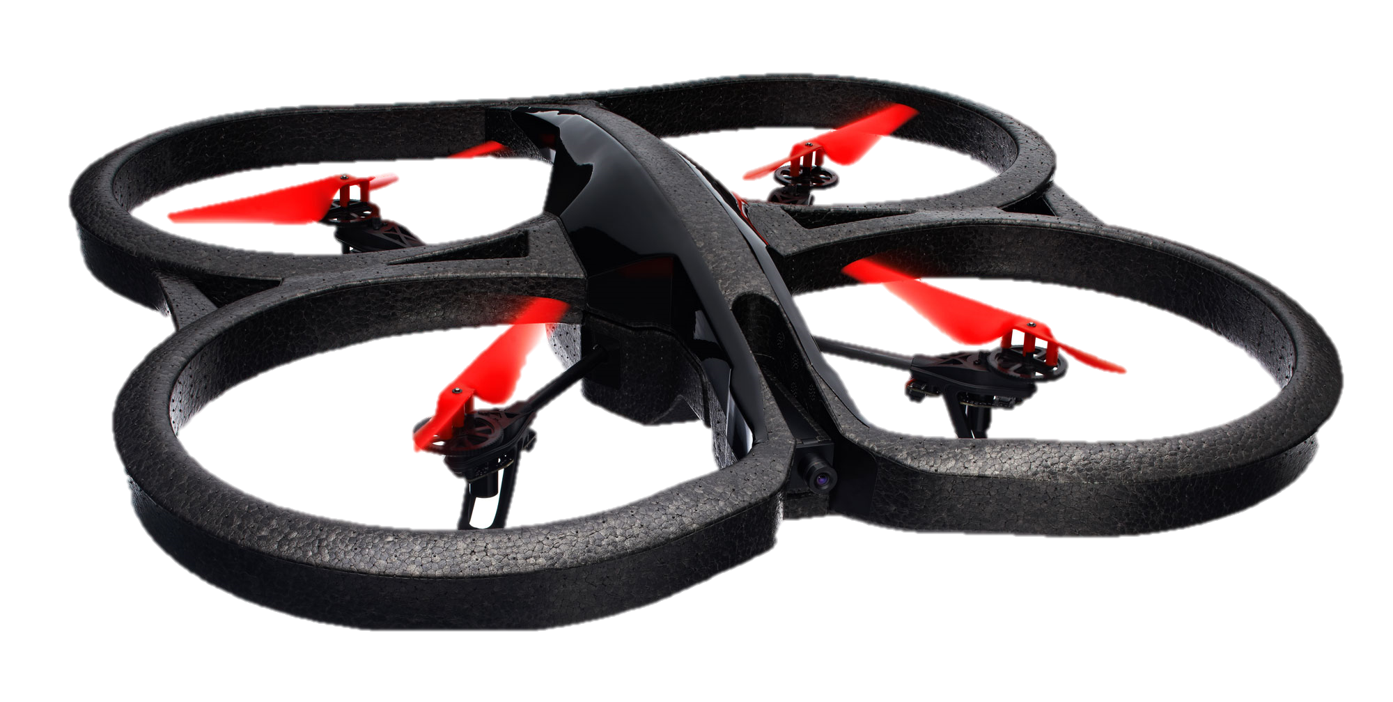
Formation Control in the Lab
4 total quadrotors in a formation
Use of cameras to keep formations
Implement SLAM

Slide 19
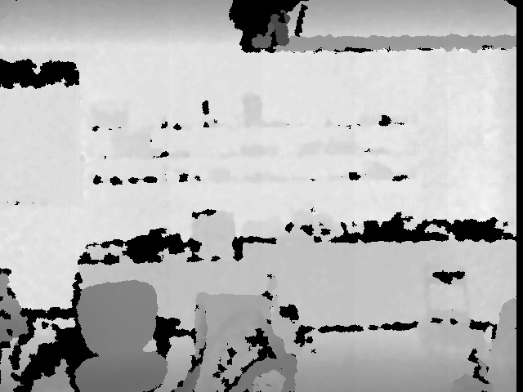
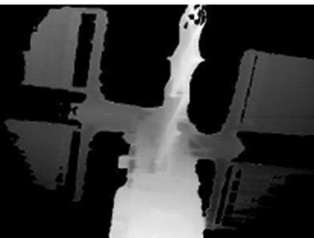
3D Depth Cameras
LiDAR
RGB-D data

Slide 20
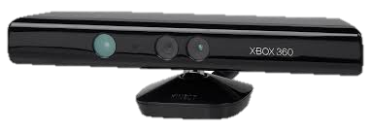
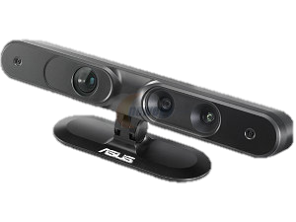
3D Depth Cameras
Xbox Kinect
Asus XTION PRO

Slide 21
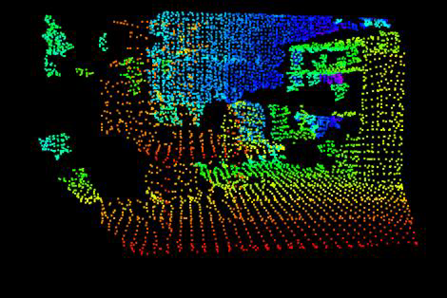
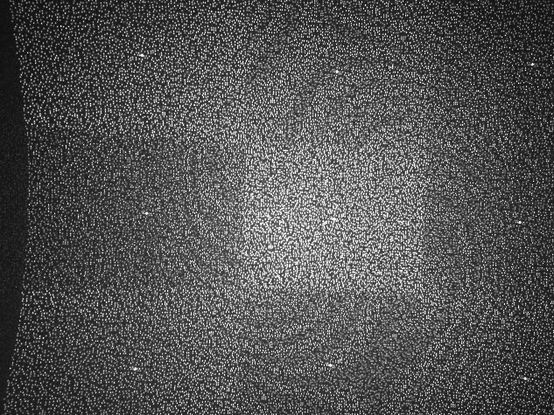
Use of the Xbox Kinect
Point clouds

Slide 22
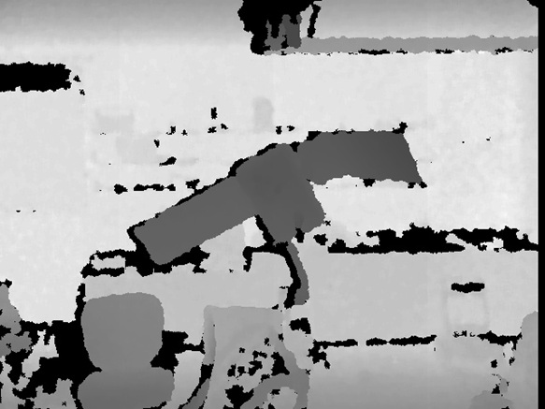
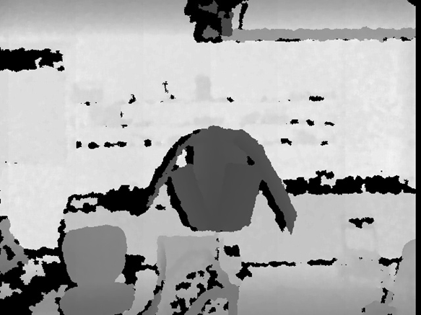
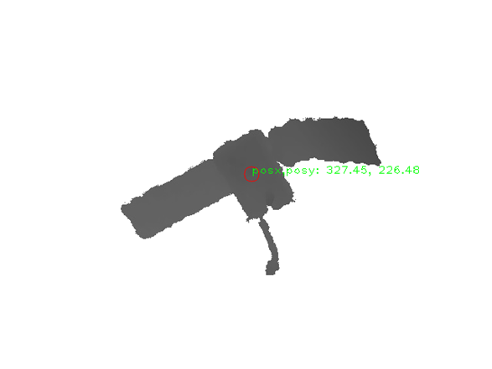
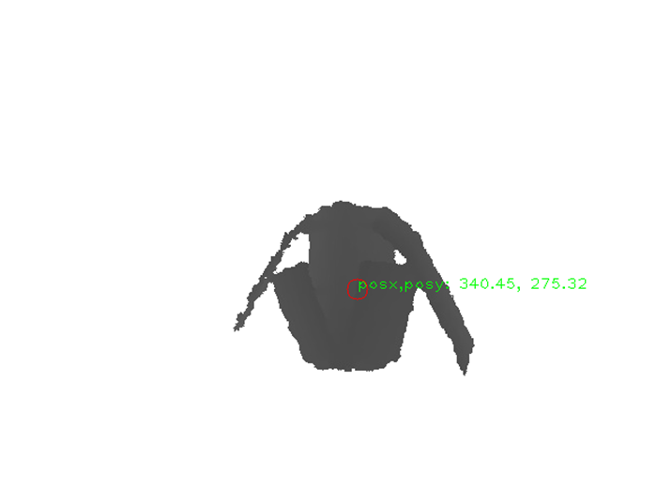
Use of the Xbox Kinect
Depth Data for controllers

